Slide 1

Data Structures and Algorithms in Java
Ansh Kapoor
00511503116

Slide 2
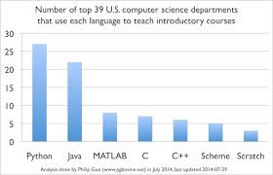
Salient Features of Java
Object oriented
Platform Independent
Secure
Portable
Multi-threaded
Memory Management
Simple

Slide 3
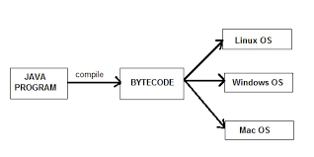
Platform Independence of Java

Slide 4
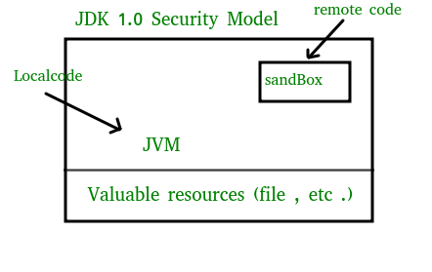
Java is Secured
Java has no explicit pointers like c and c++
Java Sandbox model provides a restricted environment to outside code

Slide 5
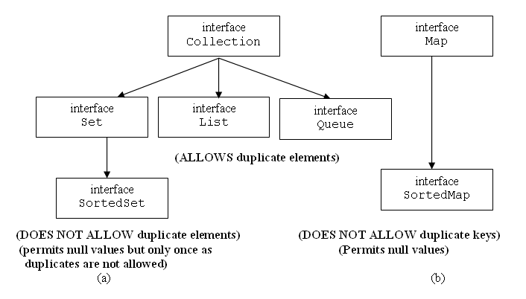
Data Structures in Java

Slide 6
Class versus Interface
Class | Interface
Does not support multiple inheritence | Supports all types of inheritence
Variables can be private | Variables should be public only
Can have constructors | Cannot have constructors
Should contain only concrete methods (methods with body) | Should contain only abstract methods (methods without body)
Class can extend other class and implements interfaces | Interface can only implement interfaces

Slide 7
Hashmaps
It stores the data in (Key, Value) pairs
To access a value one must know its key.
HashMap doesn’t allow duplicate keys but allows duplicate values. That means A single key can’t contain more than 1 value but more than 1 key can contain a single value.
HashMap allows null key also but only once and multiple null values.

Slide 8
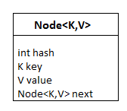
Hashmaps Advantages
Hash table lookups are O(1) in the average case, and O(n) in the worst case.
Get and search operations both are in O(1) time.

Slide 9
Algorithms Divide and Conquer
Analyzed using recurrences and master method
This strategy leads to efficient algorithms
The whole problem may be too big to solve at once
We bring the problem into seprate pieces
Solve them one by one
Combine the result

Slide 10
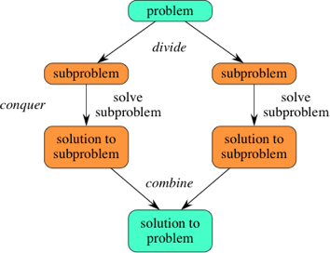
Algorithms Divide and Conquer

Slide 11
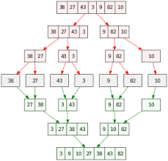
Divide and Conquer Mergesort

Slide 12
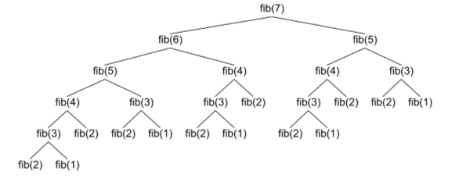
Divide and Conquer Dynamic Programming
Special case of Divide and Conquer
Optimization technique

Slide 13
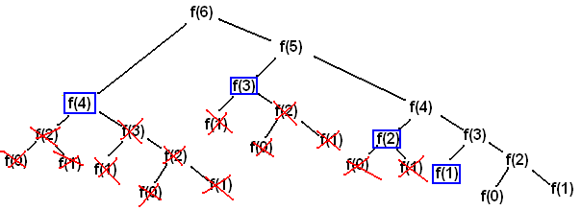
Elements of Dynamic Programming
Optimal substructure:OS holds if optimal solution contains within it optimal solutions to sub problems
Overlapping Sub-problems: Space of sub-problems must be small: recursive solution re-solves the same sub-problem many times.

Slide 14
Thank You

